Slide 1
Chapter 5

Slide 2
A Mingling of Races
South:
Mainly Anglo-Saxon, with 20% of population as Africans in the form of slaves
New England Colonies:
Least diverse due to Puritan roots.
Middle Colonies:
Received the most amount of white immigrants, especially Pennsylvania
Why is the South not receiving a lot of white immigrants during this time?

Slide 3
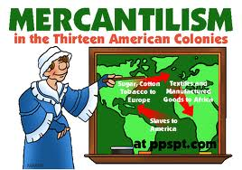
Workday America
Slow-Growing British Population
Leads to colonists to look elsewhere to sell their goods
By 1775, bulk of tobacco is being sold to France and other European countries
This goes against the idea of mercantilism
How?
Adds to the conflict between the colonists and Britain

Slide 4
The Great Awakening (Puritans)
More individuals “convert” and become active in religion again
Religious Revival in the 1730s & 40s
First mass social movement in American History
Causes:
Boring sermons
Arminianism
Directly challenged Calvinism’s predestination doctrine
Belief that individual freewill, not God, determined a person’s eternal fate
This directly challenges Puritan beliefs

Slide 5
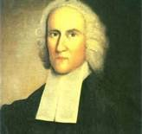
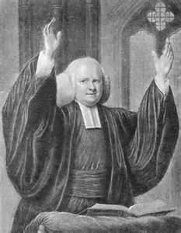
Key People
Jonathan Edwards
Credited with starting the Great Awakening in 1734
Sinners in the Hands of an Angry God
Hell was “paved with the skulls of unbaptized children”
George Whitefield
Used an electrifying new style of preaching
Many people were “saved” during his sermons

Slide 6
Effects
“Old light” vs. “New Light”
“New Light” centers: Princeton, Brown, Rutgers, and Dartmouth
Increasing competitiveness of churches
Strong democratic component
People increasingly had more choice with religion
Another important example of resistance to established authority

Slide 7
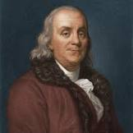
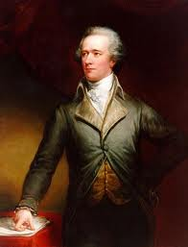
Press during Colonial Times
Poor Richard’s Almanac (Ben Franklin)
Contained sayings from the thinkers of the age and emphasized virtues of thrift and common sense.
The book was more widely read in America than anything except the Bible.
John Peter Zenger
Newspaper printer, assailed the royal governor in the paper
Charged with libel, defended by A. Hamilton, a former indentured servant
The decision was an achievement for freedom of the press and for democracy. Newspapers were now free to print responsible criticisms of powerful officials if they were true. (see 1st Amendment)

Slide 8
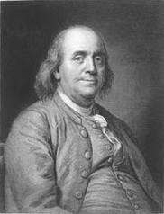
That’s It!
Questions? Comments? Suggestions?
Email me (Cirbo)
Good luck!
You know what’s cooler than discovering electricity? Visiting Mr. Norris’ APUSHReview.com website for cool videos!

